Slide 1


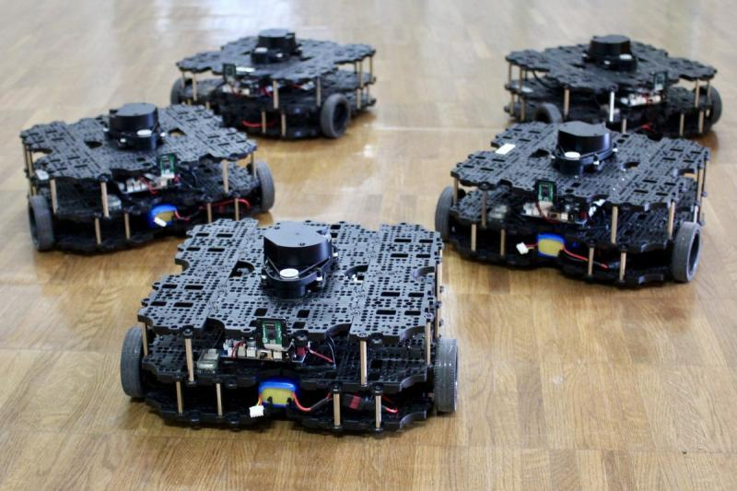

ECE693H, Spring 2025: Multi-robot System Design
“Multi-robot Systems 2”
Dr. Daniel Drew

Slide 2
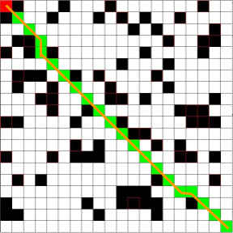
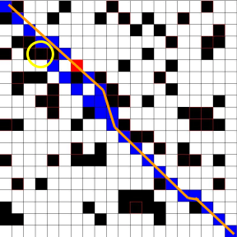
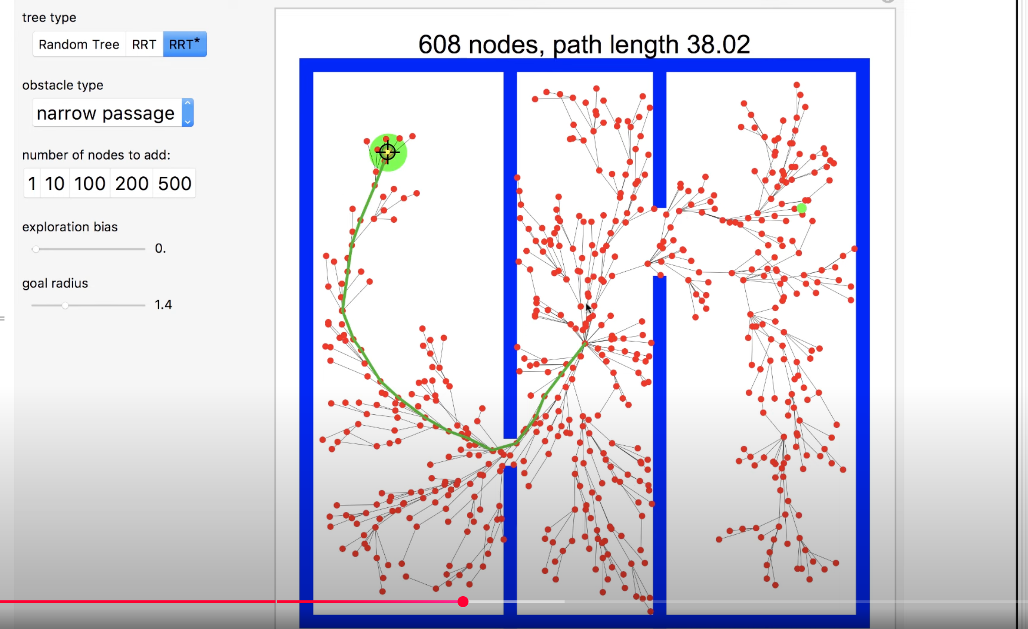
MRS Motion Planning Recap
For scenarios with an omniscient planner: A* is ubiquitous (e.g., video games)
For highly dynamic environments: D*-lite is state of the art
For large, high-dimensional state spaces: dRRT* is state of the art

Slide 3
Questions?

Slide 4
Class Overview
Lecture (~40 minutes)
Subsystem checkins (~20 minutes)

Slide 5
Multi-robot Systems: Lecture 3 of 4
Lecture 1: MRS Survey
Lecture 2: Motion Planning
Lecture 3: Task Assignment (+Motion Planning if needed)
Lecture 4: Communication and Control Paradigms

Slide 6
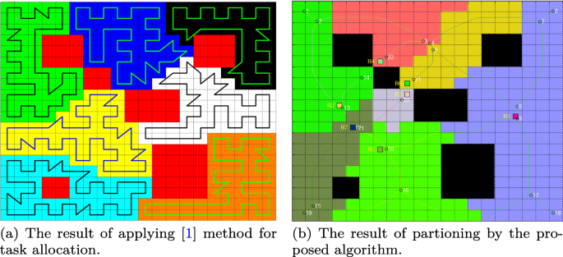
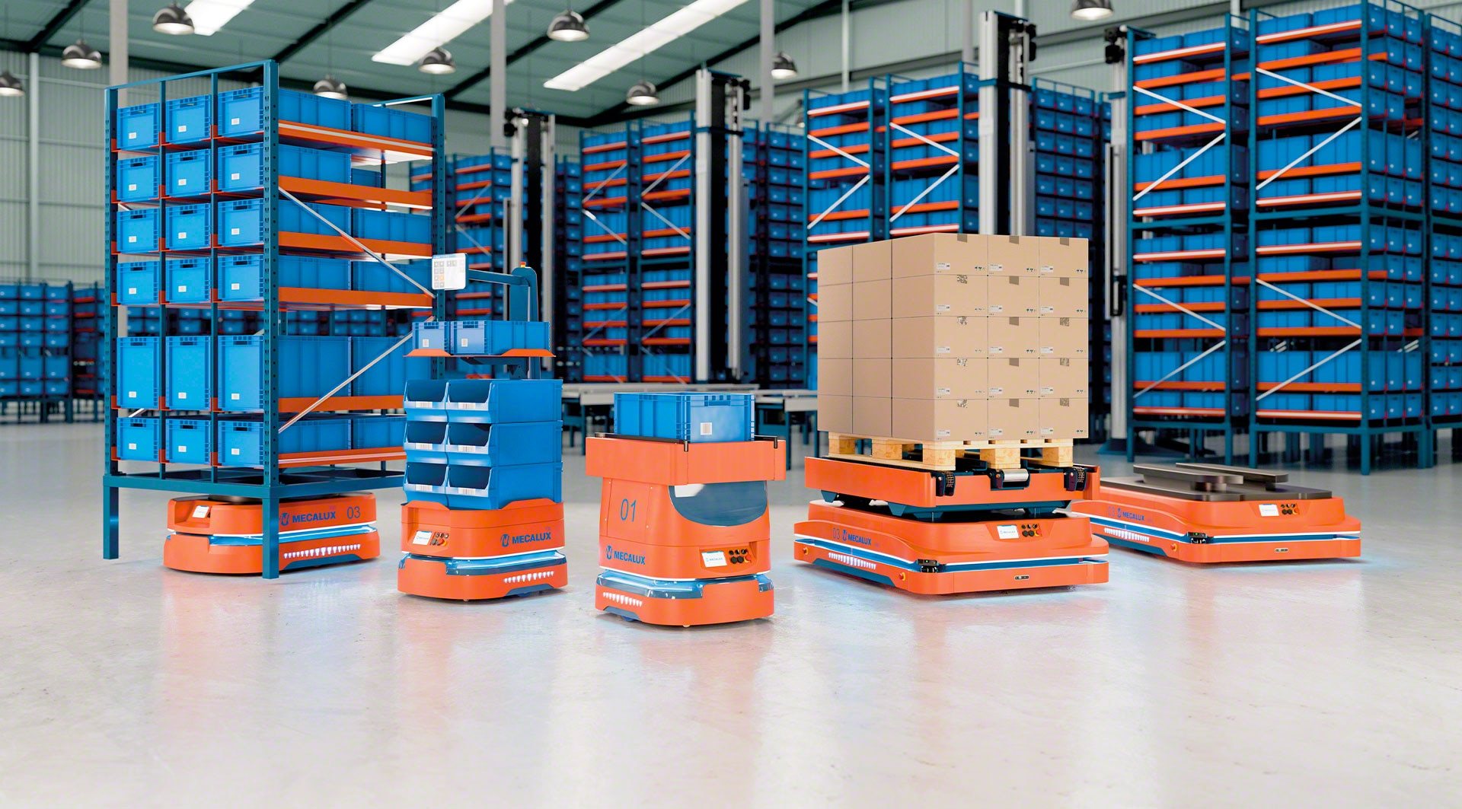
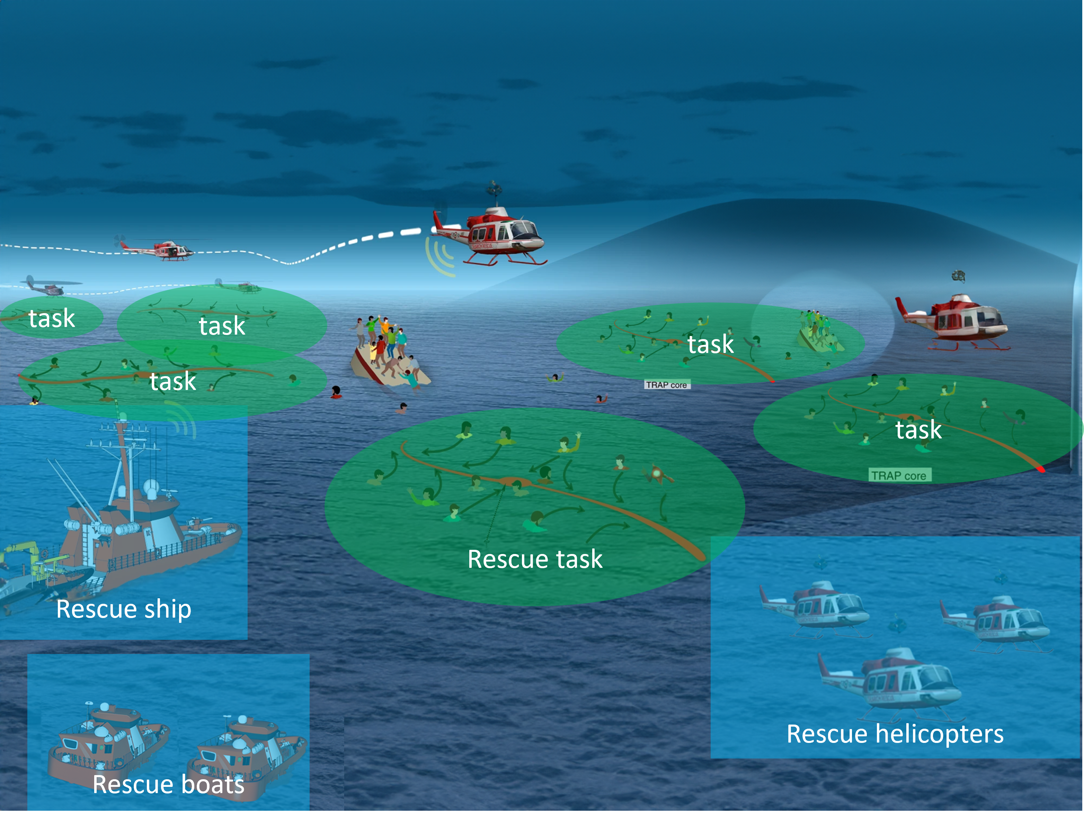
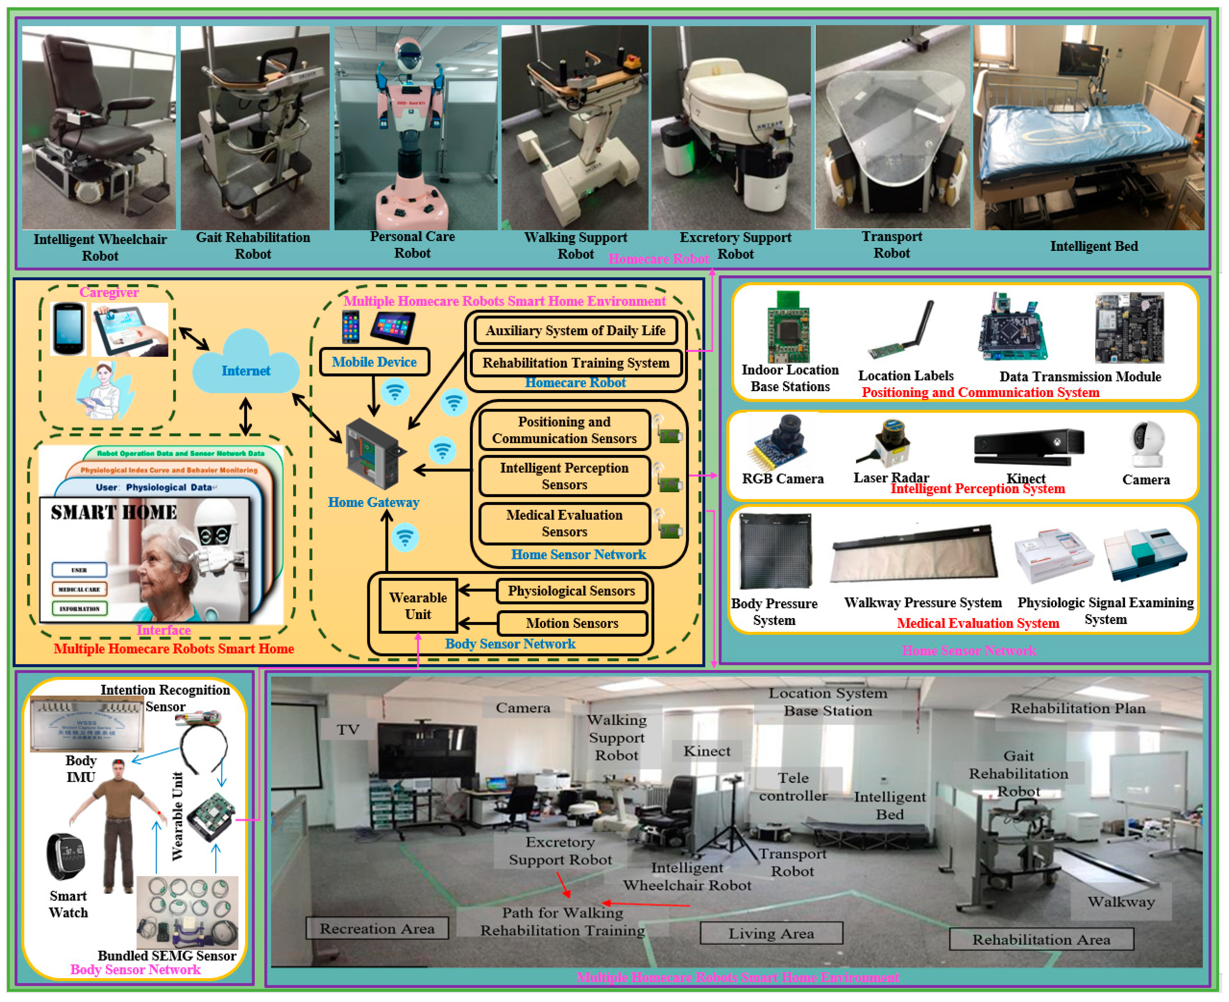
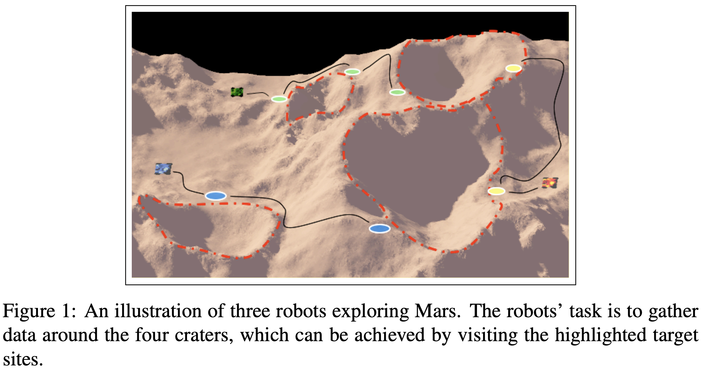
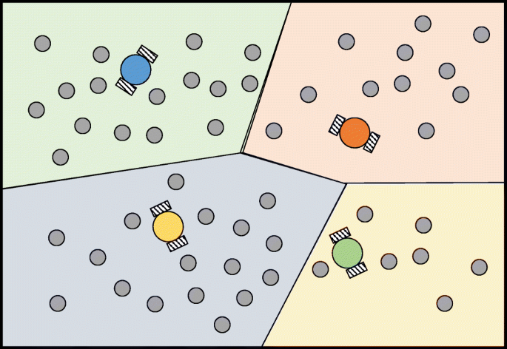
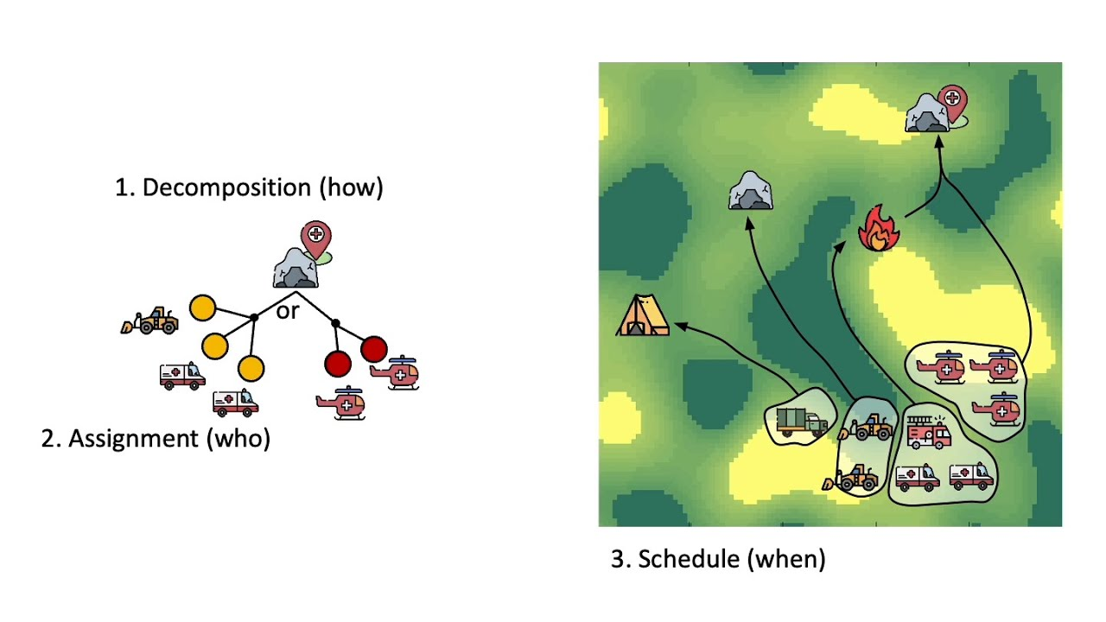
Task Assignment Examples

Slide 7
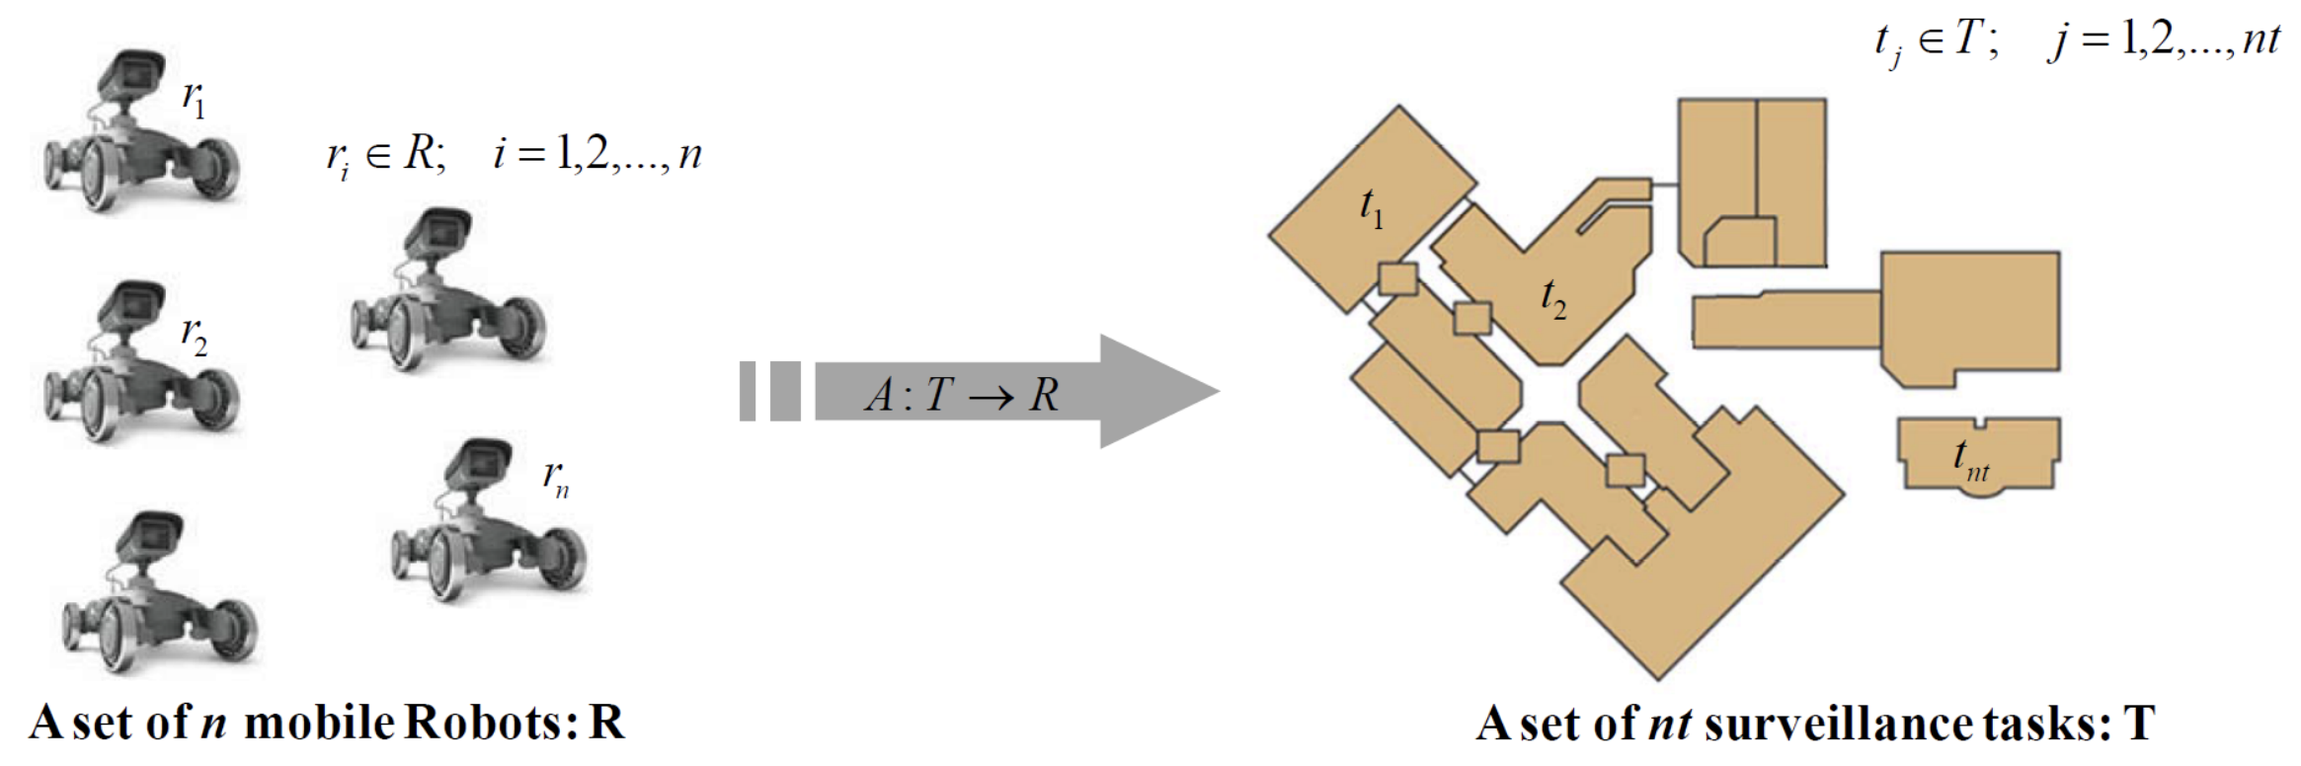
The Task Assignment Problem
$U$, the set of robot utilities, where $u_{ij}$ is the utility of robot i to execute task j
The Multi-robot Task Assignment (MRTA) problem: assign set of robots to a set of tasks such that overall performance is optimized by some metric(s), subject to some set of constraints

Slide 8
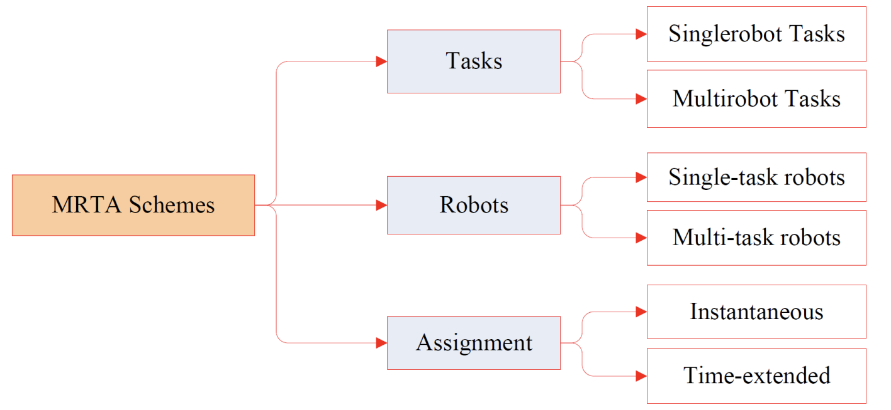
Task Assignment: Taxonomies
Instantaneous: Decisions made only based on current state
Time-extended: Planning over a finite time horizon
Offline: Assignments and planning done based on simulation / model
Online: Assignments and planning dynamically adjusted

Slide 9
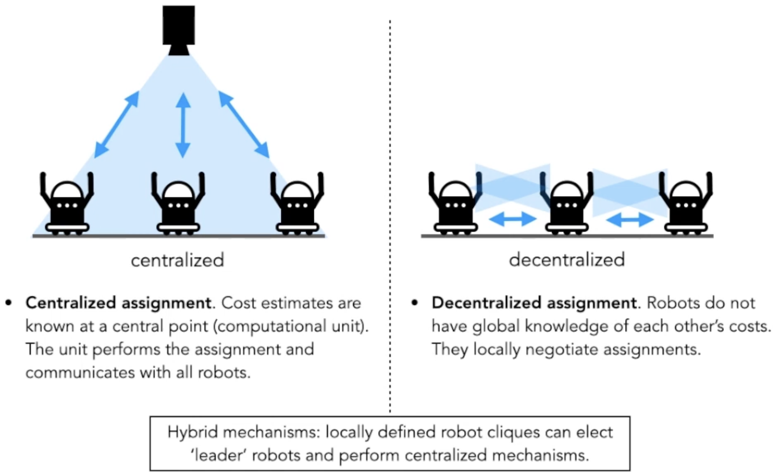
Task Assignment: Taxonomies

Slide 10
Task Assignment: Two Major Paradigms
CENTRALIZED
DECENTRALIZED
“Hungarian Algorithm”
Market-based Allocation
(various approaches)
Approaches we will not talk about:
Centralized, math-intensive (e.g., mixed-integer linear programming and other multi-factor optimization methods)
Approaches we will talk about later in the context of swarms:
Genetic algorithms, ant colony optimization

Slide 11
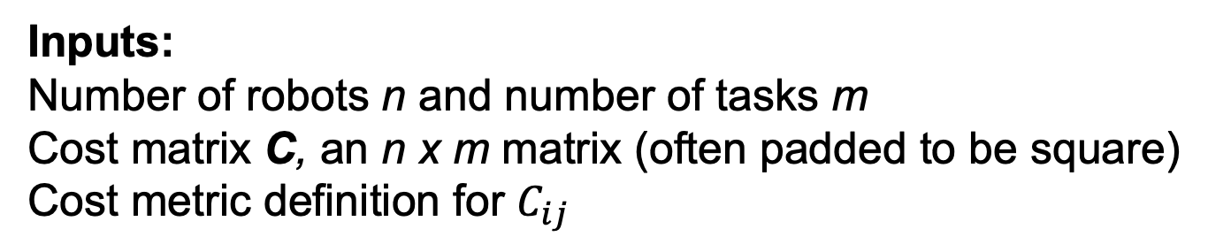
The Hungarian Algorithm (HA)
Inputs:
Number of robots n and number of tasks m
Cost matrix C, an n x m matrix (often padded to be square)
Cost metric definition for $C_{ij}$
Examples of cost metrics:
-Travel time or distance
-Energy consumption
-Execution time
-Task priority
Constraints on C for typical HA:
-Finite, comparable values
-Non-negative costs
-Independence of costs (e.g., cost should not depend on other assignments)

Slide 12
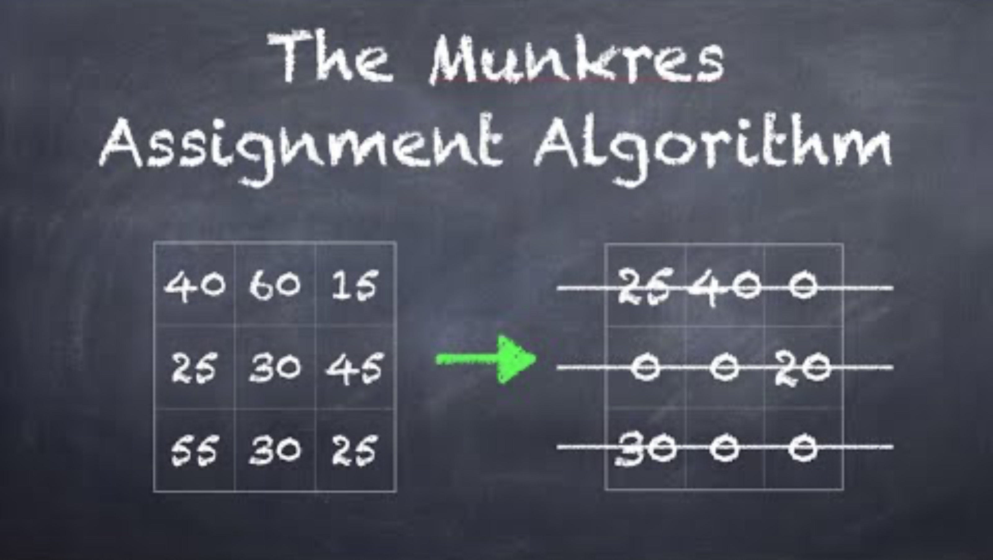
The Hungarian Algorithm (HA)

Slide 13
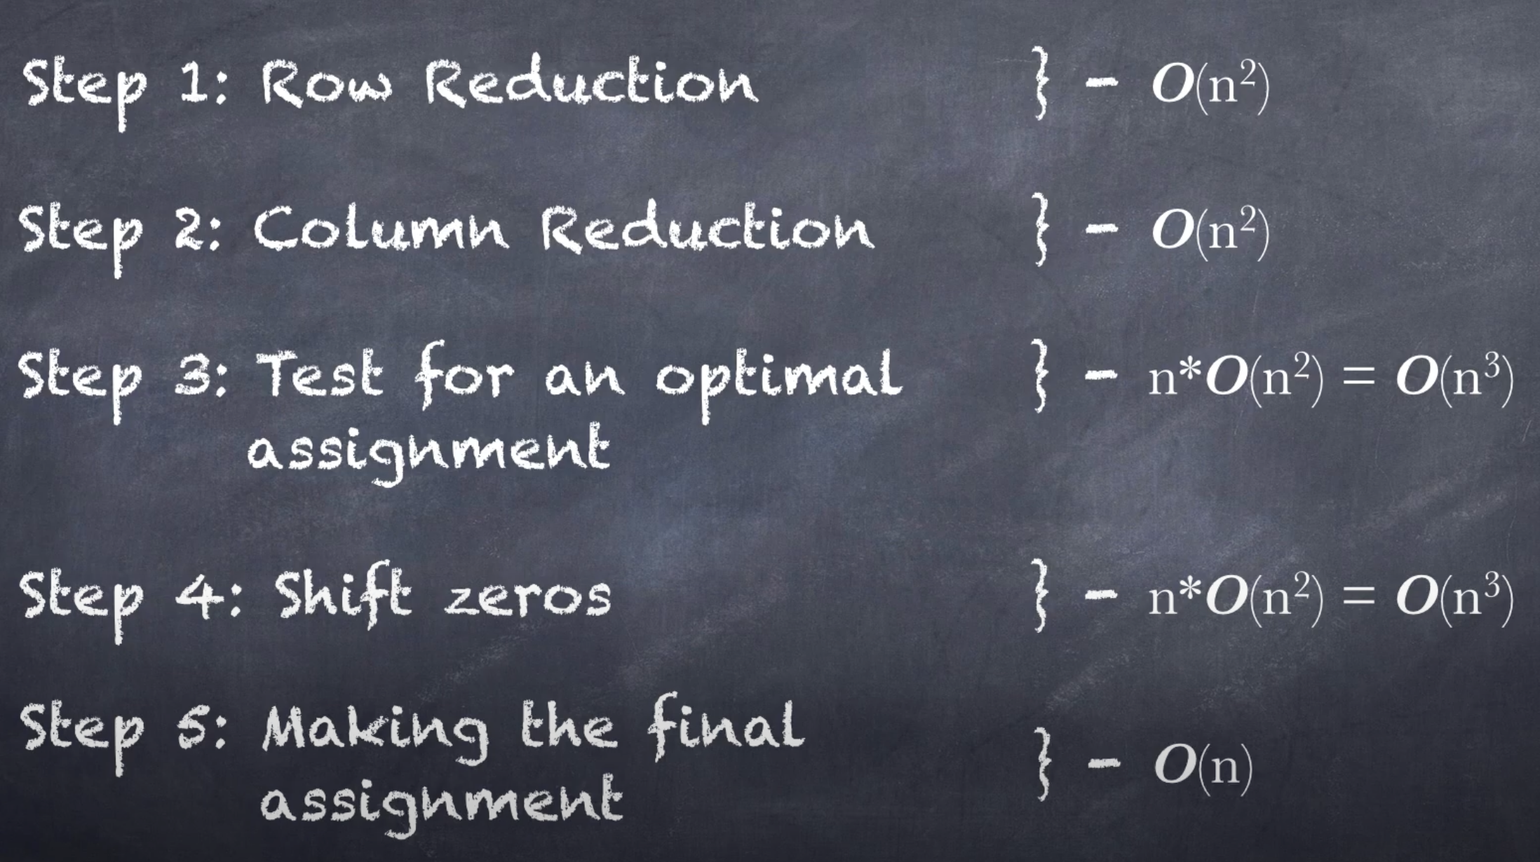
The Hungarian Algorithm (HA)
(reminder: big O notation describes how run time scales as input grows)

Slide 14
Task Assignment: Taxonomies

Slide 15
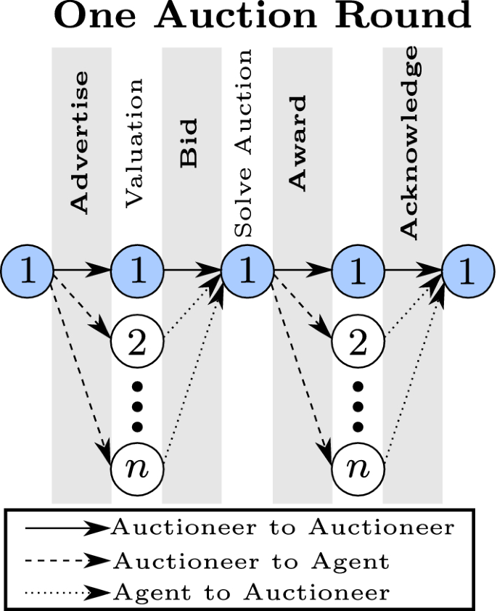
Market-based Assignment
Key Assumptions:
Robot revenue is a combination of personal and system profit
Robots work to maximize revenue
Robots are honest with eachother
Based on the “Efficient Market Hypothesis” (an important basis for capitalism), this will result in near-optimal solutions to task prices.

Slide 16
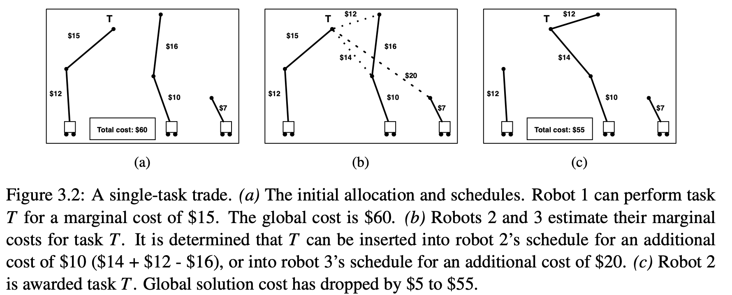
Market-based Assignment: Single Task Trades

Slide 17
Market-based Assignment: Single Task Trades

Slide 18
Market-based Assignment: Single Task Trades

Slide 19
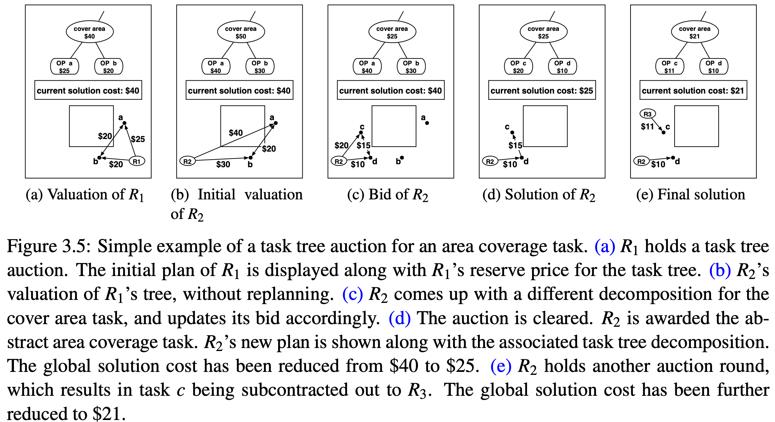
Market-based Assignment: Complex Tasks → Task Trees

Slide 20
Market-based Assignment: Complex Tasks → Task Trees

Slide 21
Market-based Assignment: Complex Tasks → Task Trees

Slide 22
Market-based Assignment: Complex Tasks → Task Trees

Slide 23
Market-based Assignment: Complex Tasks → Task Trees

Slide 24
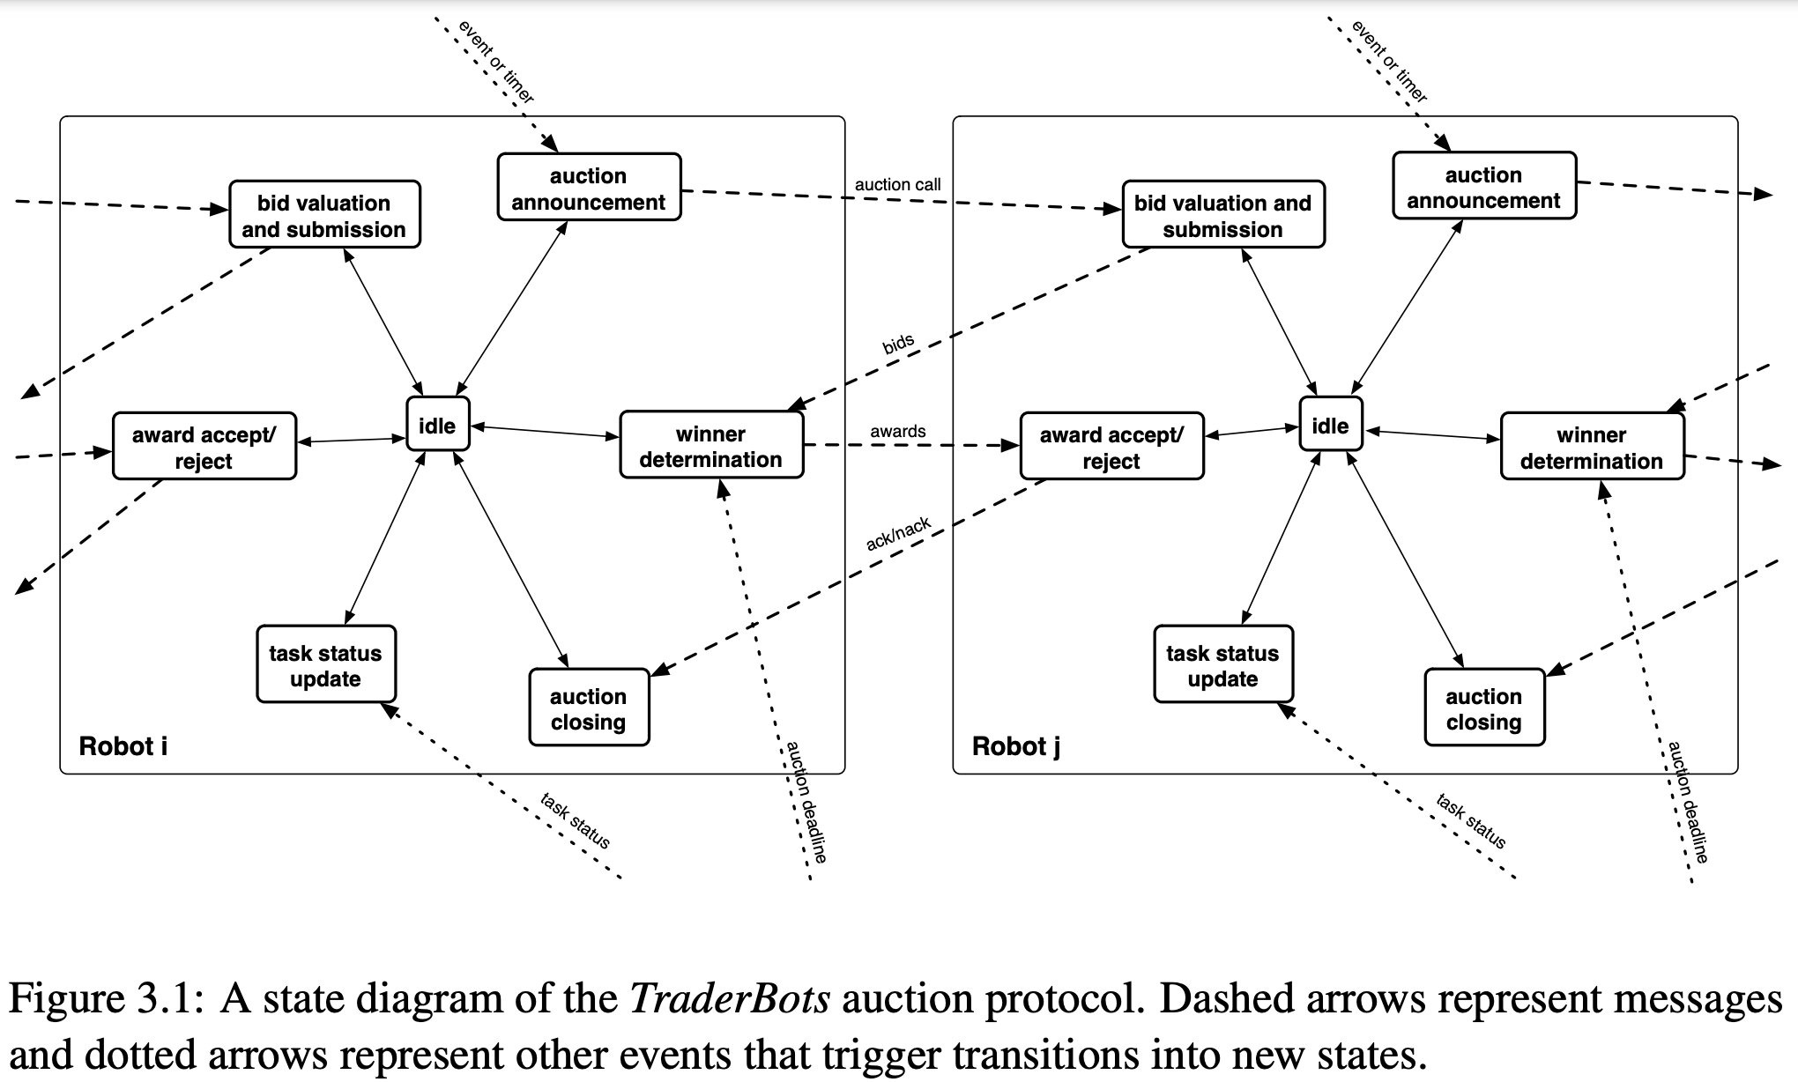
Consider a team of robots assembled to perform a set of tasks in a dynamic environment. Consider further, that the team of robots is modeled as an economy, and each robot in the team is modeled as a self-interested trader in this economy. Thus, the goal of the team is to complete the tasks successfully while maximizing overall profits (i.e. the difference between revenue and cost), while each robot will aim to maximize its individual profit. Thus, robots will hold auctions and submit bids to determine task allocations within the team, and the different tasks and information will be the commodities traded in the economy. A system such as this will inherit many desirable characteristics from the market methodology. The competitive element of the robots bidding for different tasks enables the system to decipher the competing local information of each robot (note that there is no central agent evaluating information and planning for the entire system), while the common currency provides grounding for the competing local costs in relation to the global priorities/value of the tasks being performed
Market-based Assignment: TraderBots

Slide 25
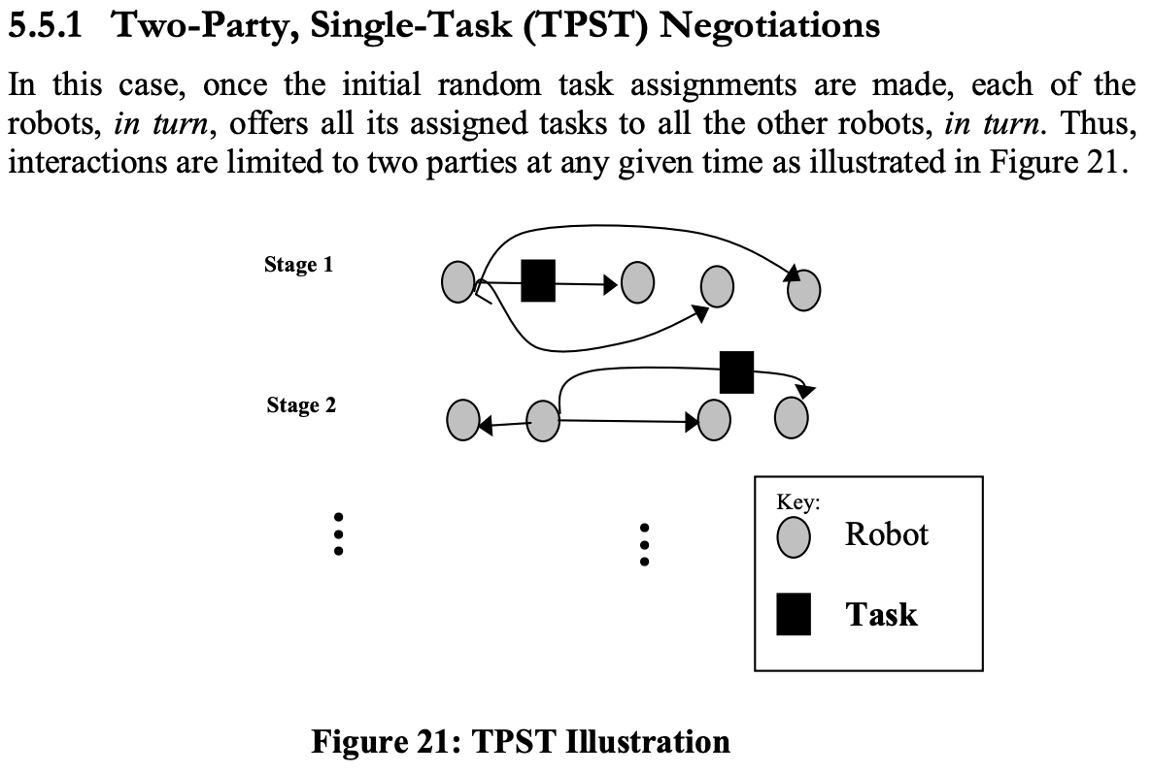
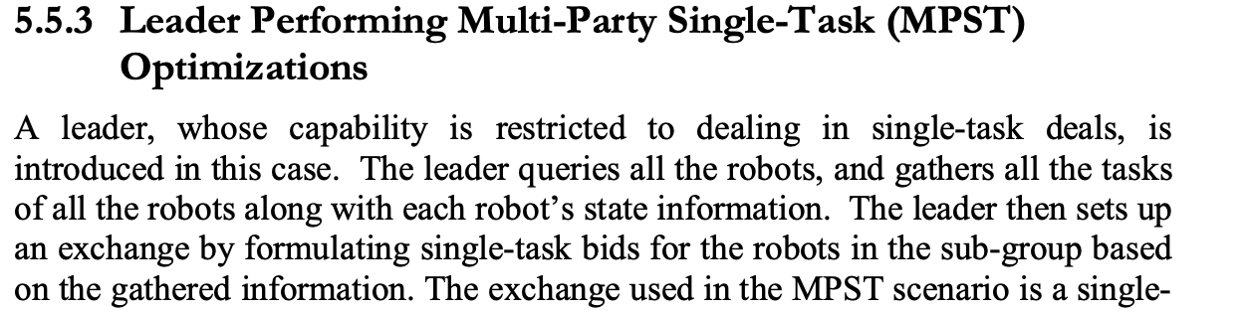
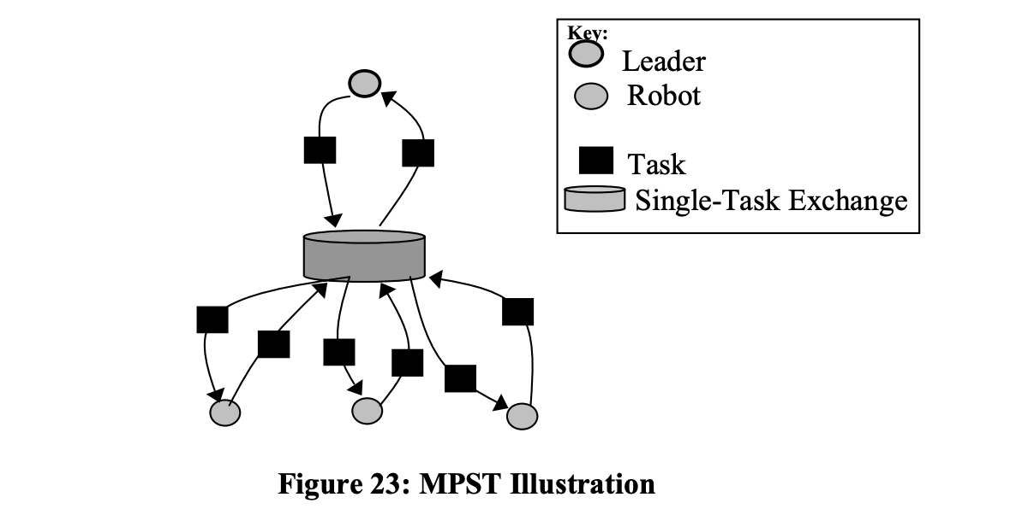
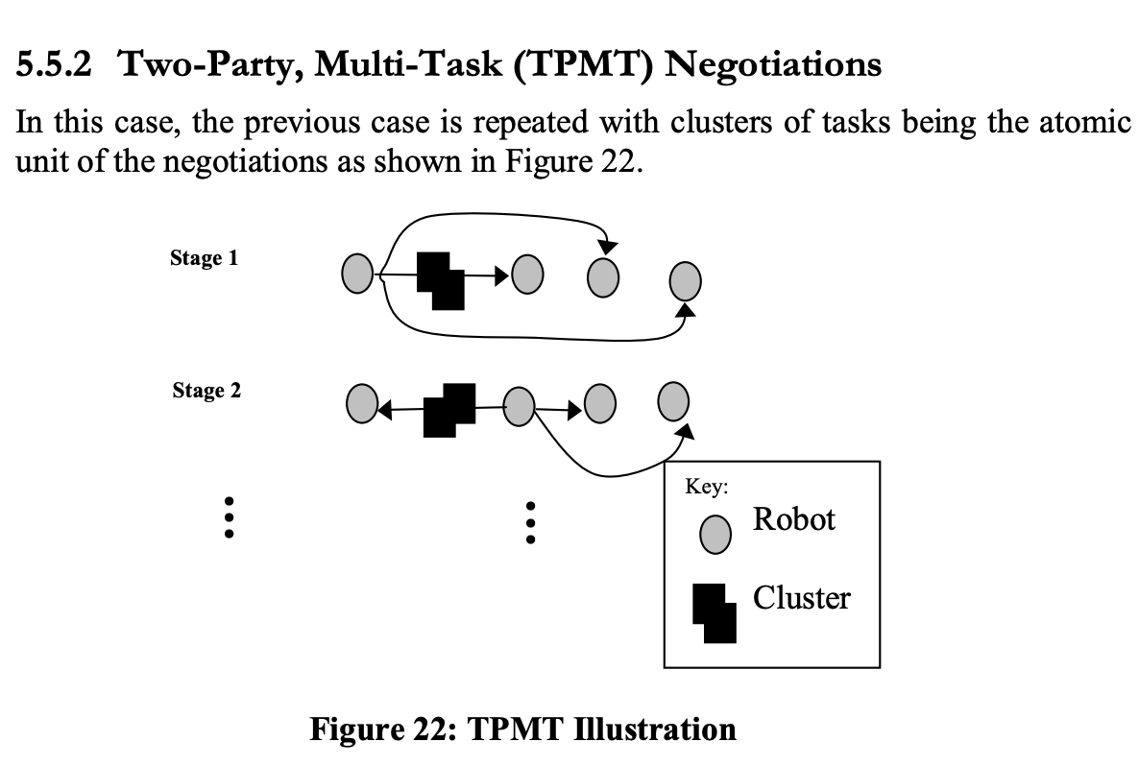
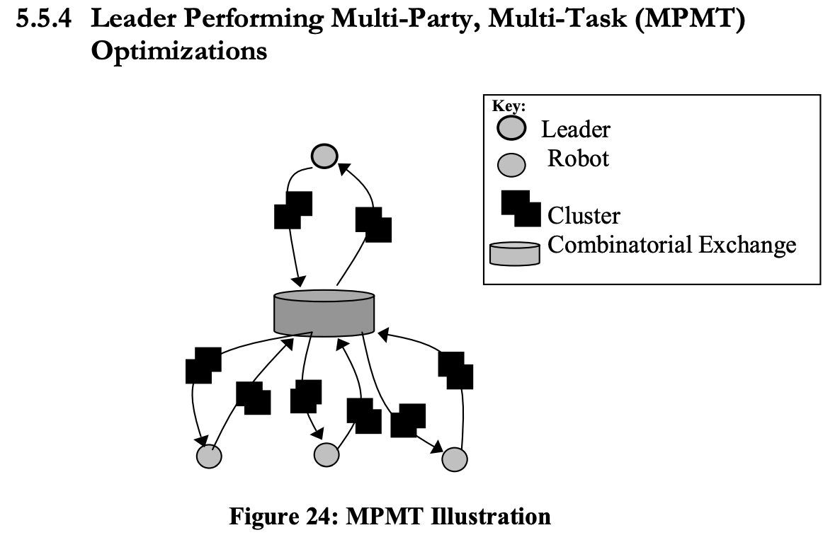
Market-based Assignment: TraderBots

Slide 26
Contrasting These Approaches
When to use decentralized market-based approaches?
Agent count scalability (computation)
Communication challenges (network scaling, single point of failure)
Complex task interdependency (constraints on cost metric for HA)
How to choose between all the market-based approaches?
How do tasks arrive?
Number of robots and tasks?
MRS composition?
Optimality vs speed?

Slide 27
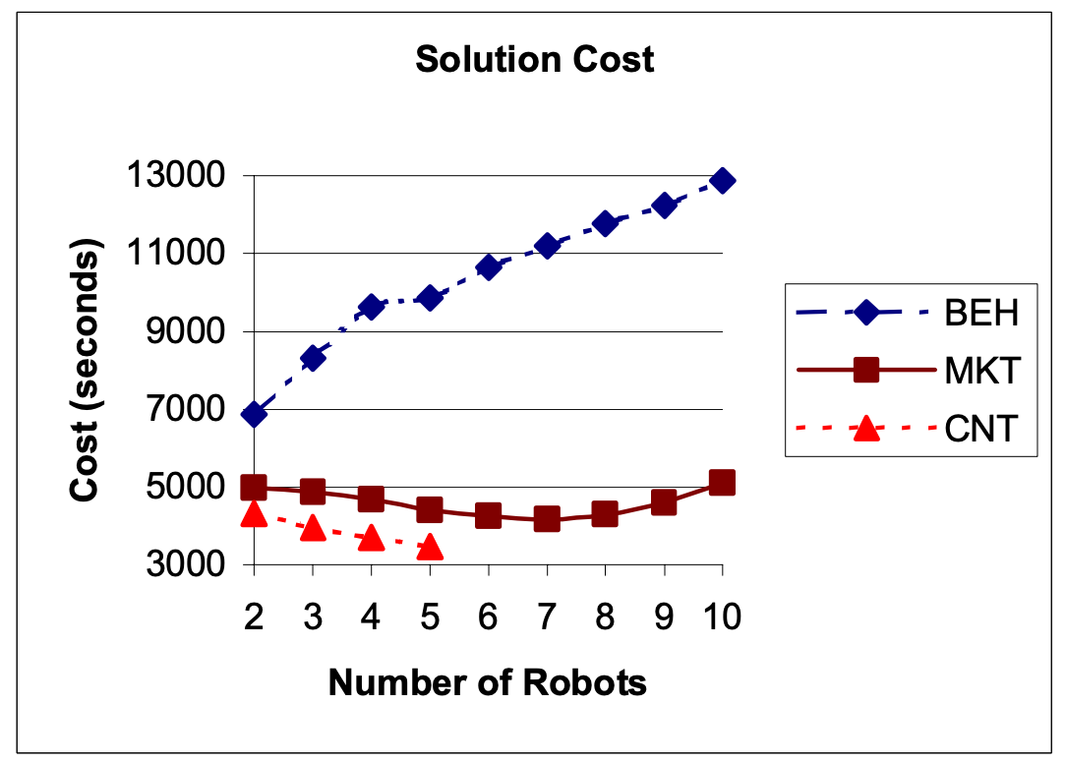
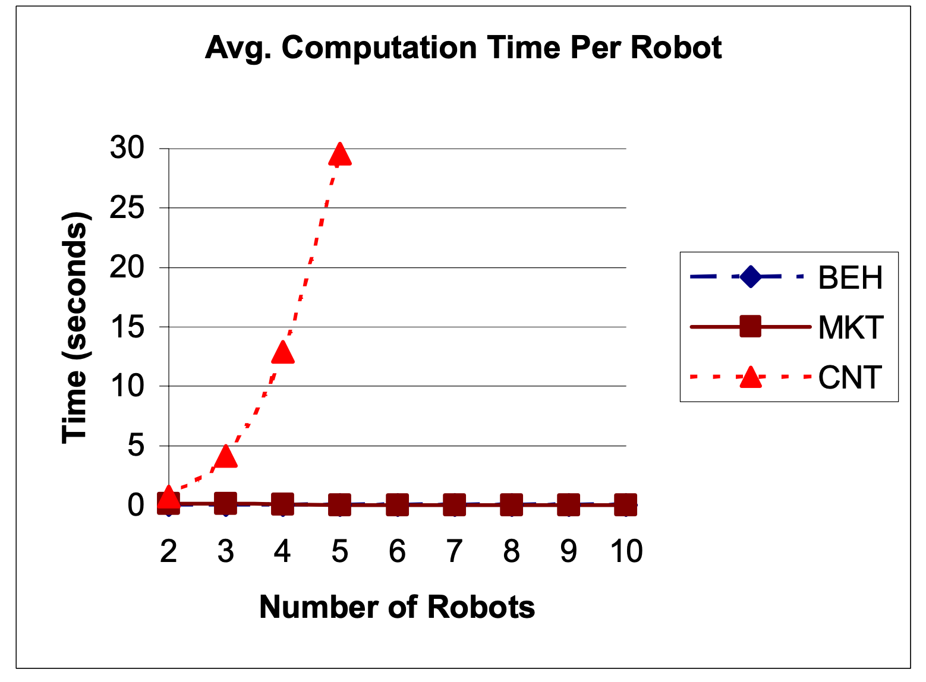
Contrasting These Approaches

Slide 28
Standard solutions?
Unlike for motion planning (e.g., with Nav2), there is no standard solution to MRTA in ROS2.
Exercise for you to think about: What would this look like?
Note: HA and fully centralized approaches are “easy” to implement.

Slide 29
Lecture (~40 minutes)
Subsystem check-in (~20 minutes)
Questions?
Questions?
Lecture 1: MRS Survey
Lecture 2: Motion Planning
Lecture 3: Task Assignment (+Motion Planning if needed)
Lecture 4: Communication and Control Paradigms

Slide 30
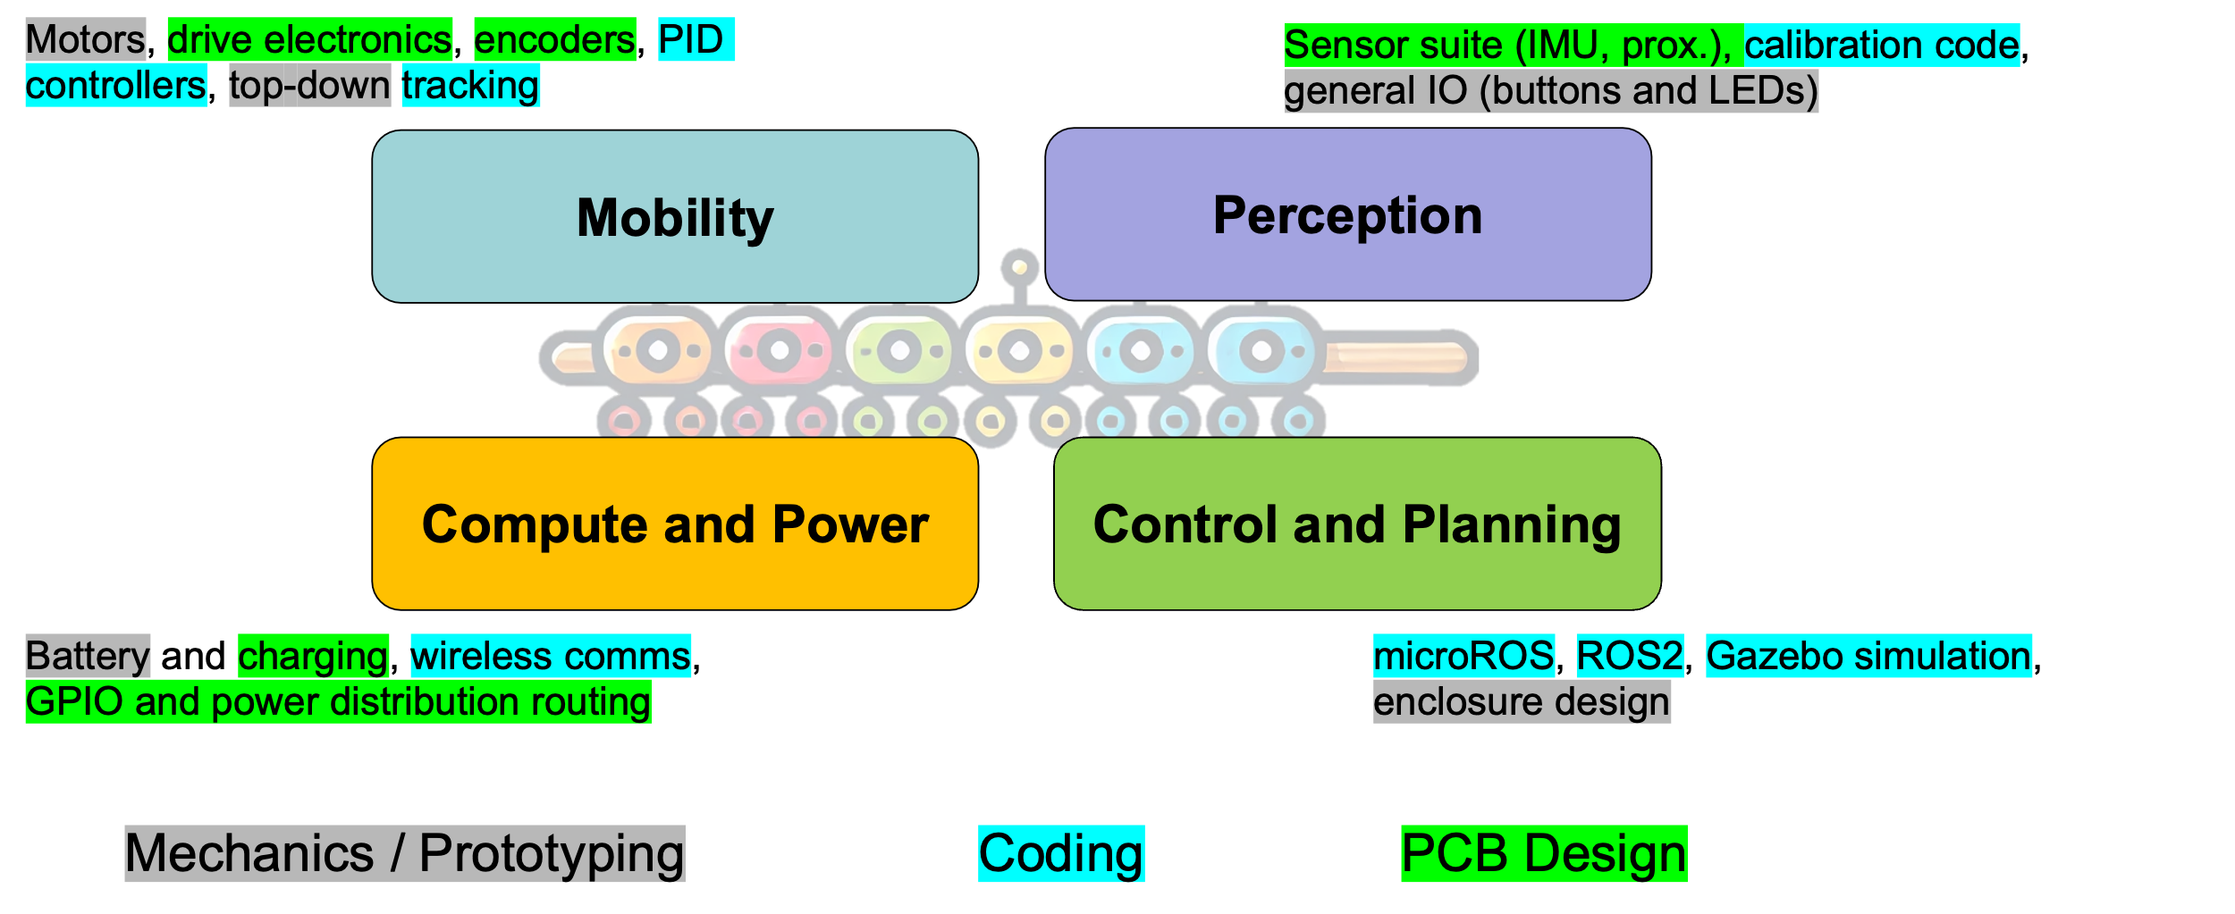
693H Robotic Subsystems
-Second Design Review Presentations are 3/10, 3/12
-You will be expected to have functional prototypes complete to show by then
-You will be expected to have PCB designs and final BoMs complete by then

